Slide 1

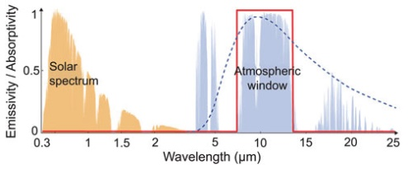
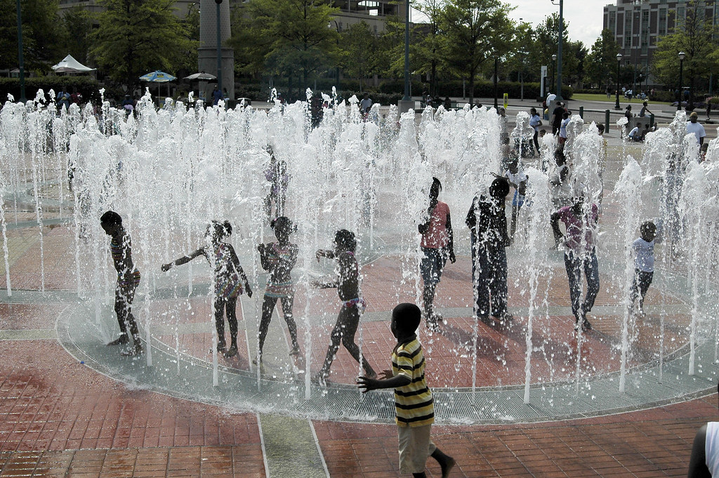
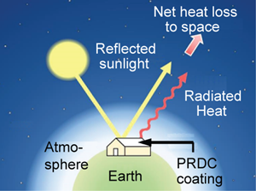
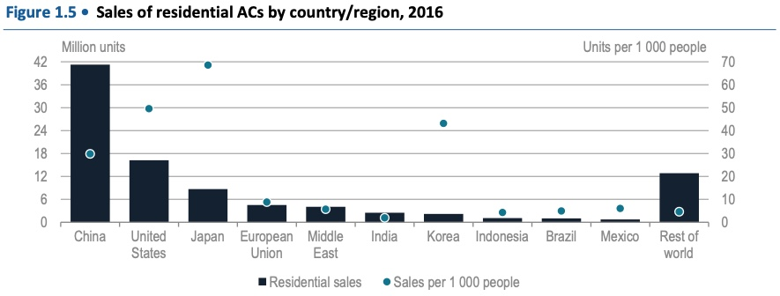
COOLING IS CRITICAL
ACs ON THE RISE
THE COOLING PROBLEM
Cooling has become more critical to humans due to global warming, rapid population growth and industrial development.
From 1990 to 2016, annual AC sales experienced a nearly fourfold increase, reaching 135 million units.
- Emission of greenhouse gases from ACs through refrigerant leakages since ACs use HFCs as a coolant.
- ACs are quite energy intensive.
- ACs don’t dissipate heat creating urban heat islands.
RADIATIVE COOLING
2 IMPORTANT CRITERIA
Occurs when objects emit more blackbody radiation than they absorb, resulting in a temperature reduction below the ambient level.
Efficiently exchanges heat with the infinite cold reservoir of space without energy consumption.
100% reflectance in the solar spectrum so the surface is not heated by sunlight in the daytime.
Emittance of 1 in the LWIR transmission window where the atmosphere is partially transparent (limited absorption by gas molecules).

